Slide 1
One and two sample estimation problems (Chap 9)
From Walpole book

Slide 2

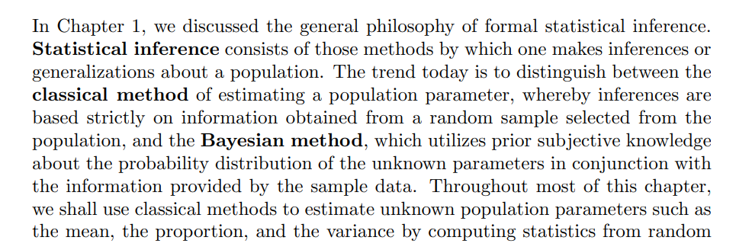
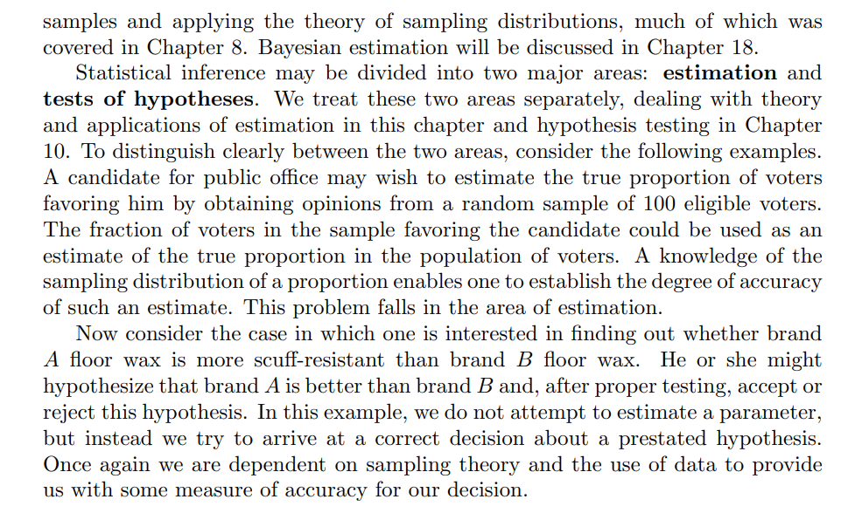

Slide 3
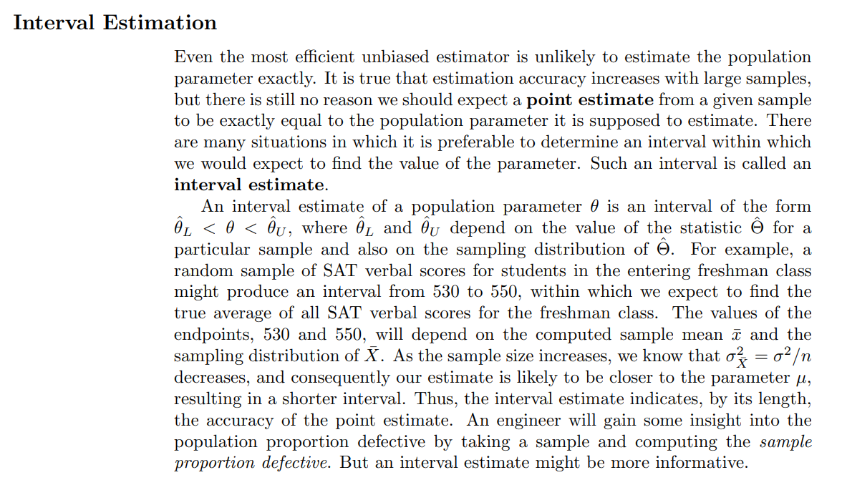

Slide 4

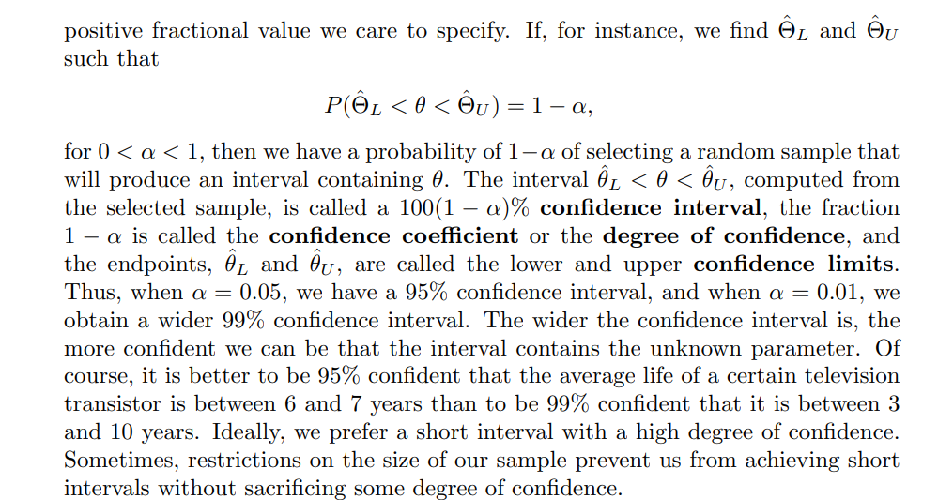

Slide 5

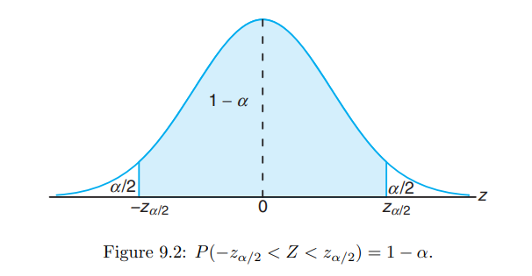

Slide 6


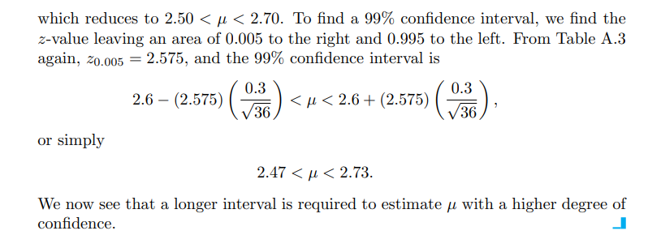

Slide 7





Slide 8


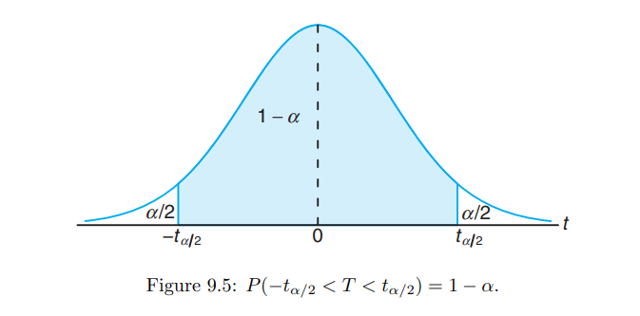

Slide 9


Slide 10




Slide 11
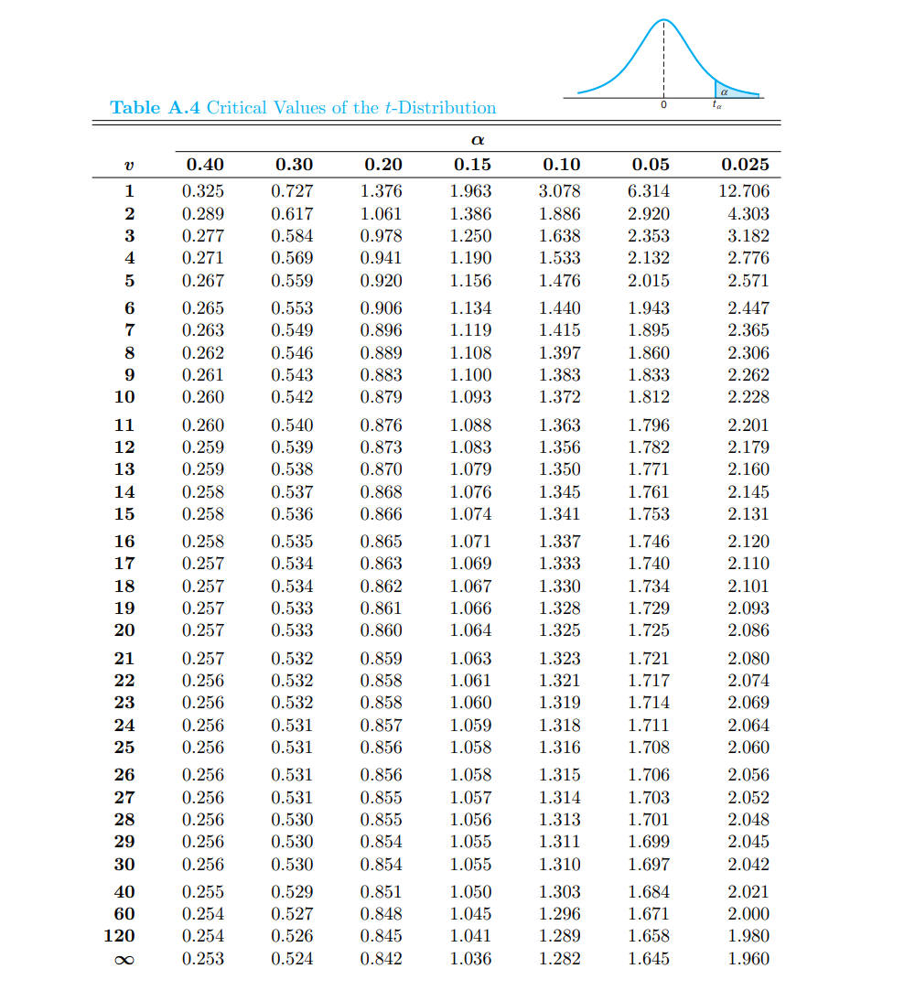

Slide 12




Slide 13



Slide 14



Slide 15



Slide 16
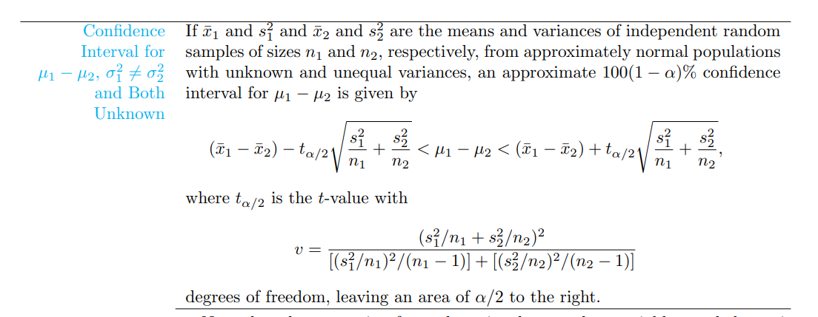

Slide 17
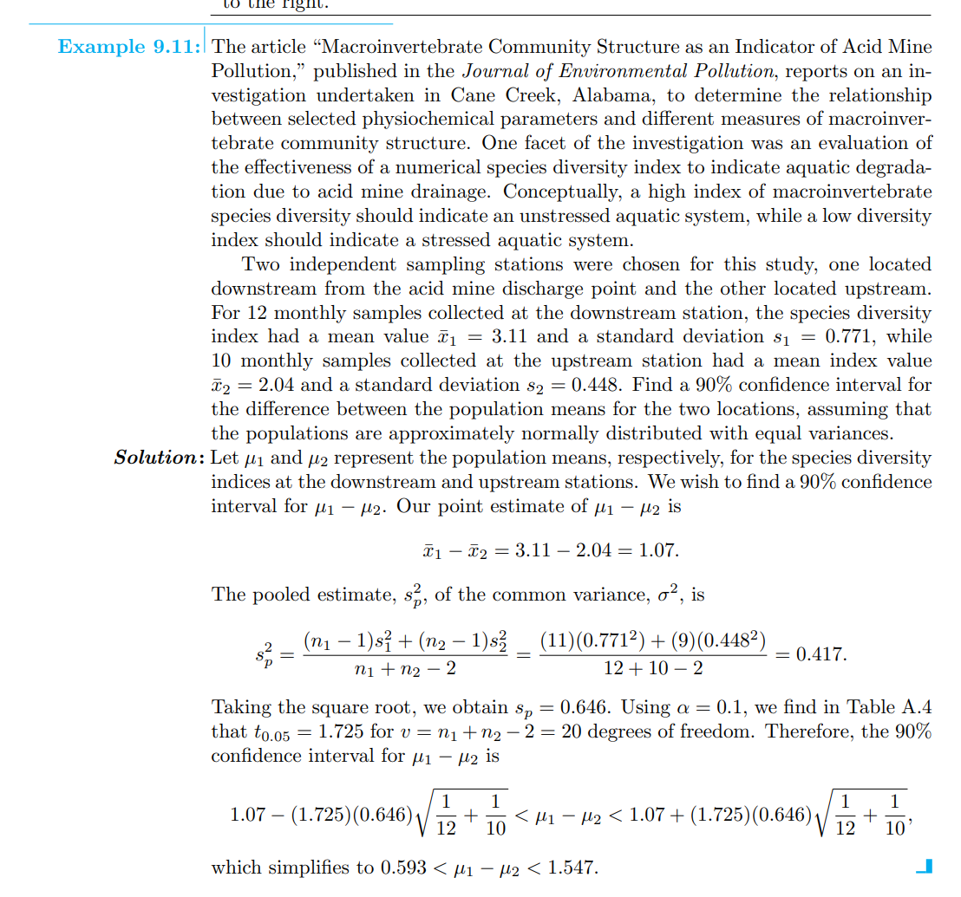

Slide 18



Slide 19
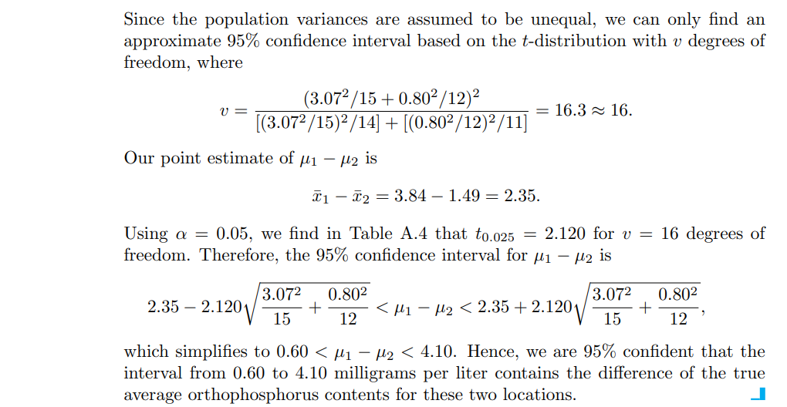

Slide 20


Slide 21

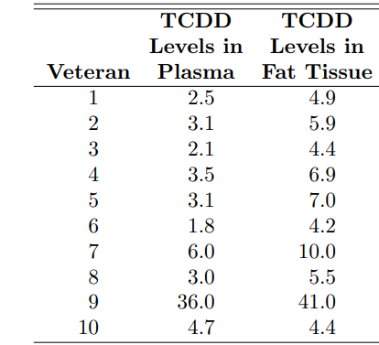





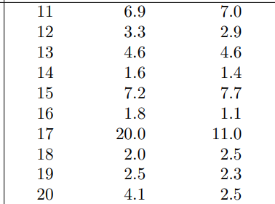
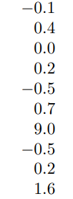


Slide 22








Summary of all estimation formulae
When $σ$ is known and n is large where for small n, population must be normal
When $σ$ is unknown, s is known and n is small (population must be normal) population
For large n, t is replaced by z
When $σ_{1}$ and $σ_{2}$ are known and $n_{1} and{ n}_{2 }are$ large where for small $n_{1} and n_{2}$, populations must be normal
When $σ_{1}$ and $σ_{2}$ are unknown but $σ_{1}=σ_{2}$ and $n_{1} and{ n}_{2 }are$ small (populations must be normal) where for large $n_{1} and n_{2}$, t is replaced by z

Slide 23




Summary of all estimation formulae
When $σ_{1}$ and $σ_{2}$ are unknown but $σ_{1}≠$ $σ_{2}$ and $n_{1} and{ n}_{2 }are$ small (populations must be normal) where for large $n_{1} and n_{2}$, t is replaced by z
Note: For only lower or upper intervals, $\frac{α}{2}$is replaced by $α$ in all formulas

